Slide 1
Behavioral Economics Versus NeoClassical Economics
Dr. Asad Zaman
Presentation at PIDE, 21st April 2014
Based on “Empirical Evidence Against Utility Theory: A Survey of the Literature”

Slide 2
Current Economic Methodology: Fundamentally Flawed
Methodenstreit: Historical, Local, Empirical Method Lost to Universal Invariant Laws.
Weber: Reality is too complex. Focus on a few simple factors.
Polanyi: Great Transformation from Traditional Society to Market Society
Market Society requires greed, pursuit of profits, lack of compassion to function.
Dramatic Conflict between Humane Social Values & Market Values.

Slide 3
Is Greed Strongest Human Motivation? Yes in Market Society
Conflict between Market & Social Norms.
Developing Market Society requires CRUSHING social norms.
No compassion for the poor.
No sense of brotherhood.
Competition instead of Cooperation.
As Market Norms Take Over, Society Breaks Down.
Enter to Learn, Leave to Earn (instead of Serve)
Doctors make Profits from Poor/Sick/Needy.

Slide 4
Behavior: Social Norms
Built in Social Norms: Compassion, Kindness, Empathy.
Market Norms: Selfishness, Greed, Competition.
Leads to Dual Personality
Experiments show human behavior depends on FRAMING.
Library Volunteers
Blood Donations
Work Bonus & Monitoring.

Slide 5
Economic Theory
Humans are COLD, CALCULATING & CALLOUS:
COLD: Not affected by emotions: purely rational calculation of self-interest.
CALCULATING: They MAXIMIZE to the last penny.
CALLOUS: Indifferent to the feelings of others.
TRUTH: This is not so, EVEN in the marketplace. Impulse Buying – Ads appeal to many kinds of emotions.

Slide 6
Experience VS Economics
Proposer Offers A Share of Total
Responder accepts: both get as proposed.
Responder Rejects: No one gets anything.
ANALYZE RESULTS AFTER PLAYING GAME

Slide 7
The ULTIMATUM GAME
ECONOMIC THEORY gives UNIQUE MAXIMIZING SOLUTION
Proposer takes ALL except for one UNIT. Responder Accepts, because ONE is more than ZERO.
Above is unique dominant strategy, JUST LIKE utility maximization.
FAILS COMPLETELY to describe human behavior.
BEHAVIORAL ECONOMICS: goal to describe human behavior (instead of axiomatizing it).

Slide 8
POLitics of knowledge
Behavioral Economics is a threatened minority group.
They seek to conform, at least outwardly.
They seek acceptance within mainstream.
They try to make MINIMAL changes to existing economic theories to bring them into conformity with observed behavior.
Prospect Theory is a good example.
Good Short Term Strategy, but not revolutionary.

Slide 9
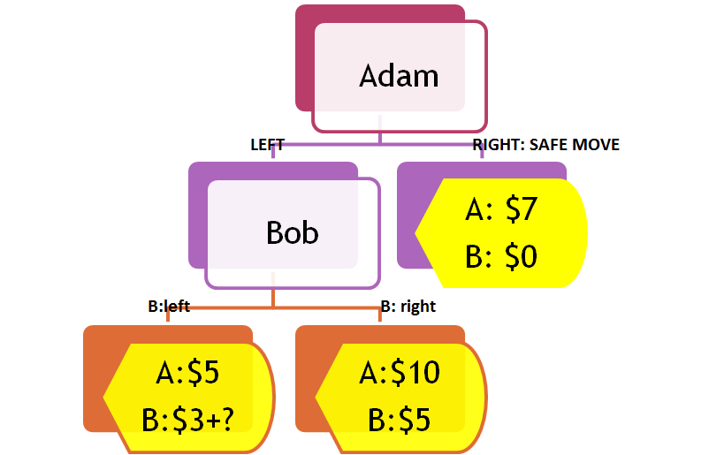
Emotional Decisons:

Slide 10
Many Emotions Involved in Decisons
Adam
Bob
A:$5
B:$3+?
A:$10
B:$5
A: $7
B: $0

Slide 11
GAME THEORY: 4 Predictions
B will pick b: right, because $5 is bigger than $3+x.
A can COUNT on B to pick right (that is, A believes that B will optimize). This will give A $10.
A will play left because $10 is more than $7.
What B gets at A:RIGHT does not matter ($0).

Slide 12
ALL 4 PREDICTIONS are WRONG
Empirically, if 3+x is close to 5, B can chose left. Choice between Right and Left DEPENDS on DIFFERENCE – CONTRARY to game theory.
A KNOWS this, and picks SAFE $7 more often when 3+x is close to 5, less often when x=0.
Untrained people BETTER at predicting human behavior than economic models.
Above shows violations of first three.

Slide 13
4th Prediction: Wrong REVENGE:
Adam
Bob
A:$5
B:$3
A:$10
B:$5
A: $7
B: $100

Slide 14
4th Prediction: Wrong GRATITUDE:
Adam
Bob
A:$15
B:$3
A:$10
B:$5
A: $20
B: -$100

Slide 15
Lessons: Many Emotions Involved in SIMPLE DECISIONS
Carelessness, Indifference
RECIPROCITY
Caring for Others

Slide 16
Cooperation & Trust: PUZZLES for Economics
Theory: Cooperation is long run selfishness.
Practice: People dont make long run calculations.
Theory: Selfish Behavior Maximizes LR Welfare.
Practice: Generous & Cooperative Behavior maximizes LR welfare.
Scarcity Thinking Versus Abundance – mindsets: Amir Wahbelbari
“Scarcity: Why Having Too Little Means So Much” Sendhil Mullainathan, Eldar Shafir

Slide 17
Cross Cultural Behavior
Generosity is a UNIVERSAL behavior, contrary to Economic Theory
Preference, Outcomes, Enjoyment all depend on social norms, and cultural conditioning.
Process is often more important than outcomes.
Institutional & Socio-Cultural Details matter

Slide 18
Virtues of Cooperation
The famous Prisoner’s Dilemma, EXTENSIVELY Studied. Betray, Betray is dominant strategy. Cooperate, Cooperate most frequent outcome
Player I ↓ | Player II→ | Cooperate | Betray
Cooperate |  | (High, High) | (Sucker, Temptation)
Betray |  | (Temptation, Sucker) | (Low, Low)

Slide 19
Behavioral Studies SHOW:
“Cheap Talk” has strong effect on outcomes
Size of Temptation & Sucker payoff matters systematically.
Cooperation is strong in repeated games. According to game theory, no cooperation in finite repeated games.

