Slide 1

Disaster Management in Pakistan
(Experiences and Challenges)
By
Major General Muhammad Saeed Aleem
Chairman National Disaster Management Authority

Slide 2


Slide 3
Sequence
DM System in Pakistan
Climate Change Impact
DM Experiences
Way Forward
Challenges
Capacity Building

Slide 4
Historical Perspective

Slide 5
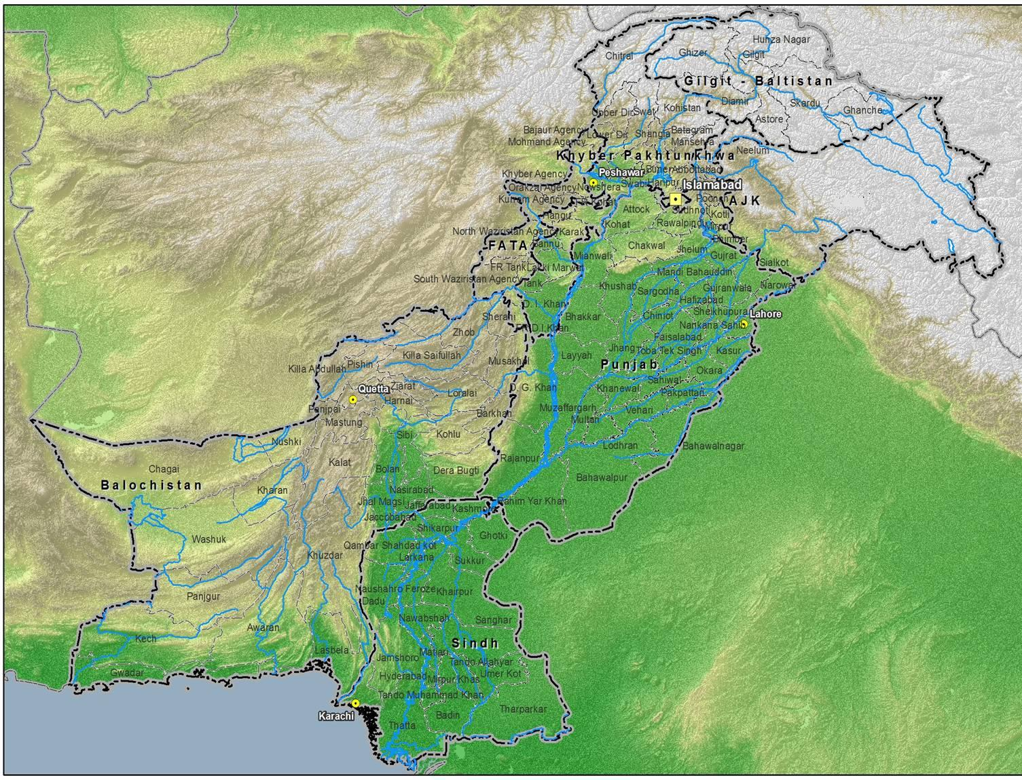
Pakistan’s Disaster Context
China
Afghanistan
Disputed Territory
India
Iran
Area - 790,000 sq Km
180 million people
Topographic & Climatic Contrasts
Variety of hazards
Notes:
Pakistan is a large country with around 790,000 sq. KM area, over 180 million people. It is a country with great topographical and climatic contrasts. It has all kinds of topographical features from coastal beaches, sandy deserts, plateaus, fertile plains, high mountains and snow covered peaks and glaciers. One of the largest river systems i.e. Indus runs trough the length of Pakistan. Therefore, we are faced with a number of hazards including ………

Slide 6
Hazards in Pakistan
Hydro-meteorological Hazards
Oil Spill
Flash Floods
Riverine Floods
GLOF
Snow slides
Drought
Cyclones
Urban Floods
Avalanches
Industrial
Hazards
Tsunami &
Cyclone
Landslide
Avalanches
Cont…..
6
Notes:
Pakistan is a large country with around 790,000 sq. KM area, over 180 million people. It is a country with great topographical and climatic contrasts. It has all kinds of topographical features from coastal beaches, sandy deserts, plateaus, fertile plains, high mountains and snow covered peaks and glaciers. One of the largest river systems i.e. Indus runs trough the length of Pakistan. Therefore, we are faced with a number of hazards including ………

Slide 7
Hazards in Pakistan
Geological Hazards
Oil Spill
Industrial
Hazards
Earthquakes
Tsunami
Landslides
Tsunami &
Cyclone
Landslide
Avalanches
Cont…..
7
Notes:
Pakistan is a large country with around 790,000 sq. KM area, over 180 million people. It is a country with great topographical and climatic contrasts. It has all kinds of topographical features from coastal beaches, sandy deserts, plateaus, fertile plains, high mountains and snow covered peaks and glaciers. One of the largest river systems i.e. Indus runs trough the length of Pakistan. Therefore, we are faced with a number of hazards including ………

Slide 8
Hazards in Pakistan
Manmade Hazards
Oil Spill
Industrial Accidents
Epidemics / Pandemics
Oil Spills
Fires
Displacements
Air Crash
Industrial
Hazards
Tsunami &
Cyclone
Landslide
8
Notes:
Pakistan is a large country with around 790,000 sq. KM area, over 180 million people. It is a country with great topographical and climatic contrasts. It has all kinds of topographical features from coastal beaches, sandy deserts, plateaus, fertile plains, high mountains and snow covered peaks and glaciers. One of the largest river systems i.e. Indus runs trough the length of Pakistan. Therefore, we are faced with a number of hazards including ………

Slide 9
Evolution of DM System
2005-2015 - Hyogo Framework for Action (HFA)
2005 - Earthquake - Federal Relief Commission (FRC) and ERRA
2007 - NDM Ordinance
2007 – Raising of NDMA
2010 – NDM Act

Slide 10
Disaster Management Structure
National Disaster Management Act
NDMC
NDMA
Stakeholders
PDMAs
DDMAs
PDMCs
Federal Level
Provincial Level
Policy Formation / Backup / Facilitator
Enabler
Climate Change
Division
NDRF
NIDM
Corps of
Volunteers
Implementation

Slide 11
Disaster Management Cycle
Risk Assessment
Structural / Non Structural
Govt
Reconstruction
MHVRA
Prevention/Mitigation
Govt /HC
Rehabilitation
Agencies / CSOs / Community
Awareness and Capacity
Building
Govt /HC
Recovery
Preparedness
Govt / HA / Community
Govt / CSOs/
Intl Community
Relief
Early Warning
Agency to Community
Rescue
Disaster
Govt / CSOs/ Community

Slide 12
Stakeholders – DM Structure
NDMA
Provinces
Federal Ministries
Media
Donors
NHN / PHF
UN / IOs
Community
Armed Forces

Slide 13
DM System in Pakistan

Slide 14
NDMC Composition
Prime Minister - Chair
Leaders of Opposition - Senate / National Assy
Ministers (Defence, Foreign Affairs, Finance, Interior, Comms, Health & Social Welfare)
Governor KP (for FATA)
Provincial Chief Ministers including Gilgit-Baltistan
Prime Minister AJ&K
Chairman JCSC
Civil Society Representatives
Co-opted Members - appointed by Prime Minister
Chairman NDMA -Secretary

Slide 15
NDMC Functions
Lay Down Policies on Disaster Management
Approval of National Plan
Lay Down Guidelines to be followed by for Federal Govt / Provincial Authorities
Take Measures for Prevention of Disaster, Mitigation, Preparedness and Capacity Building
Arrange for and Oversee, Provision of Funds for the purpose of mitigation measures, Preparedness and Response
Provide such support to other Countries Affected by Major Disasters as Federal Govt may determine
Approve plans prepared by Ministries or Divisions of the Federal Govt in accordance with National Plan

Slide 16
NDMA Functions
Act as the implementing, coordinating and monitoring body for Disaster Management
Prepare National Plans on Disaster Management.
Implement, coordinate and monitor the implementation of National Policies / Plans
Lay down guidelines for preparing Disaster Management plans by different Ministries / Depts and Provincial Authorities
Provide necessary technical assistance to Provincial Governments / Provincial Authorities for preparing plans
Cont…..

Slide 17
NDMA Functions
Coordinate Disaster Response in the event of any threatening disaster situation or disaster
Lay down guidelines for and give directions to concerned Ministries or Provincial Governments / Provincial Authorities regarding measures to be taken in response to any threatening disaster situation or disaster
Promote general education and awareness in relation to disaster management
For any specific purpose or general assistance requisition the services of any person
Any other function which NDMC may require to perform

Slide 18
NDMA Functions
Policy Formulation
Implementation
Coordination
Monitoring
For Entire Spectrum of Disaster Management

Slide 19
PDMA Functions
Formulation of provincial disaster management policy
Coordinate and monitor implementation of the National Policy, National Plan and Provincial Plan
Examine vulnerability of different parts of the Province to different disasters and specify prevention or mitigation measures
Evaluate and enhance preparedness at all governmental or non-governmental levels to respond to disaster
Coordinate response in event of disaster
Lay down guidelines to be followed for preparation of DM Plans by Provincial Departments and District Authorities
Give directions to Provincial Departments or DDMAs regarding actions to be taken in response to disaster
Cont…..

Slide 20
PDMA Functions
Promote general education, awareness and community training in DM
Provide necessary technical assistance or give advice to District and Local authorities for carrying out their functions effectively
Advise Provincial Govt regarding all financial matters in relation to disaster management
Examine the construction in the area and if it is of the opinion that standards laid down have not been followed, it may direct for following the same to secure compliance of such standards
Ensures that communication systems are in order and DM drills are being carried out
Perform such functions as may be assigned to it by National or Provincial Authority

Slide 21
DDMA - Composition
Chairman
Head of local council at district level (ex-officio)
District Coordination Officer/Deputy commissioner
District Police Officer (ex-officio)
Executive District Officer, Health
Other district level officers to be appointed by District Govt
(Rescue 1122)
3rd & Most Critical Tier
Members

Slide 22
DDMA - Composition
Sukkur District
Total Members: 24
Deputy Commissioner
Syed Khursheed Ahmad Shah, MNA NA – 198 & Leader of Opposition
Syed Nasir Hussain Shah, MPA PS-11
SSP Sukkur
ADC 1
ADC II
Chief Municipal Officer
Chief Officer (District Council)
Superintending Engineer (W&S)
Distr Health Officer
Distr Education Officer
Distr Officer (Social Welfare)
Distr Health (Live Stock)
Deputy Director (Civ Defence)
Executive Engineer (Irrigation)
Asst Director (Local Govt)
Cantonment Executive Officer
2 x member from Chamber of Commerce
2 x Doctors
1 x member from CSO (Hilal-e-Ahmer)
2 x Agriculturists

Slide 23
DDMA Functions
Prepare a disaster management plan including district response plan
Ensure following of guidelines as laid down by the National and Provincial Authorities by all departments at district and local authorities level
Ensure vulnerable areas are identified and preventive measures taken by all at district level
Coordinate and monitor implementation of National Policy, Provincial Policy, National Plan, Provincial Plan and District Plan
Give directions to different authorities at district level for prevention or mitigation of disasters
Cont…..

Slide 24
DDMA Functions
Lay down guidelines for preparation of disaster management plans at the district level and local authorities in the district
Organize and coordinate specialized training programmes
Monitor implementation of disaster management plans prepared by the Departments at the district level
Facilitate community training and awareness programmes for prevention /mitigation of disaster
Cont…..

Slide 25
DDMA Functions
Prepare, review and update district level response plan and guidelines
Identify buildings and places as potential relief centres and make arrangements for water supply and sanitation in such buildings or places
Review development plans prepared by the Departments of the Government at the district level
Coordinate with local authorities in the district to ensure pre-disaster and post-disaster management activities
Establish stockpiles of relief and rescue materials and ensure availability at short notice
Set up, maintain, review and upgrade the mechanism for early warnings and dissemination of proper information to public
Cont…..

Slide 26
DDMA Functions
Encourage involvement of NGOs and voluntary social-welfare institutions for disaster management
Perform all assigned functions or as it deems necessary for disaster management in the District
Ensure viability of communication systems
Provide information to the Provincial Authority relating to different aspects of disaster management

Slide 27
Climate Change Impact

Slide 28
Impact of Climate Change
5th IPCC Assessment Report
5th Assessment Report of Inter-Governmental Panel on Climate Change (IPCC) finds, beyond reasonable doubt, since 1950s, rate of global warming has been unprecedented, compared to previous decades and millennia
Globally, sea levels have risen faster than at any time during previous two millennia and the effects are felt in South Asia
Changing patterns of rainfall and melting snow and ice are affecting the quantities and quality of water available in many regions, including South Asia
Climate change will influence flooding, heat related deaths and food / water shortage in South Asia

Slide 29
Observed Effects of Climate Change
5th IPCC Assessment Report
Asian region as a whole experienced most climate related disasters in the world between 2000-2008
While sea levels are rising including Asia, most Asian deltas are sinking as a result of ground water extraction, flood plain engineering and trapping of sediments by dams
Extreme rainfall is causing illness, deaths and mass displacements
Contaminated Urban Flood waters have caused exposure to disease and toxic compounds
Dengue breakout in South Asia has been associated with high temperatures and heavy rainfall. Mental Disorders and post traumatic stress disorders syndrome have also been observed in disaster prone areas
Climate change negatively impacts livelihoods in highly vulnerable areas

Slide 30
Global Climate Change Implications
5th IPCC Assessment Report
0.6 C increase in average global temperature during last century
Increase by 1.5 – 4.6 C projected over 21st century
Large changes (both increase and decrease) of temperature and precipitation in different world regions
Considerable increase in frequency and intensity of extreme climate events
Large scale melting of mountain glaciers and polar ice caps
Sea level rise (19 cm over 20th century – further rise by 44-73 cm projected over 21st century)

Slide 31
Pakistan’s Climate Change Concerns
5th IPCC Assessment Report
Increased variability of monsoon
Projected recession of HKH glaciers threatening IRS flows
Increased risks of extreme events
Severe water and heat stressed conditions in arid and semi-arid regions
Increase in deforestation; Loss of biodiversity
Increased intrusion of saline water in Indus delta
Health Risks

Slide 32
Climate Change - Pakistan’s Experience
Inconsistent Behaviour of Monsoon
Melting Glaciers
Extreme Climate Events
Increasingly Heavy Downpours
Societal Impacts
Variable Intensity, Spatial & Temporal Spread
Water, Energy, Agriculture, Health, Potential Displacements and Conflicts
In Karakoram / Himalayas Ranges
400 mm rain in Sialkot in 48 hrs in 2013
200 mm rain in Islamabad in 24 hrs in 2013
668 mm rain in Plandri in 24 hrs in 2014
440 mm rain in Rawalakot in 24 hrs in 2014
Summers are becoming hotter
Notes:
32

Slide 33
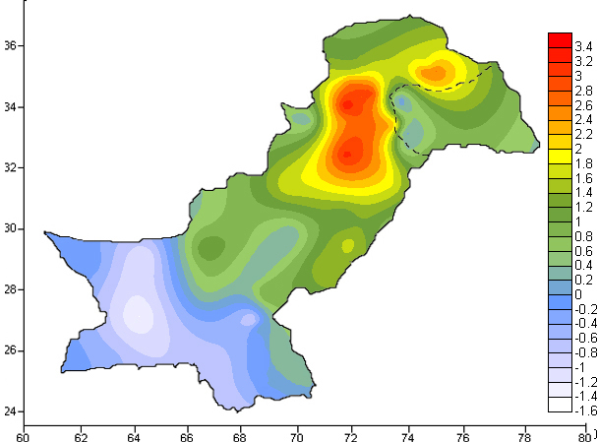
Rainfall Shift
Shift in monsoon rainfall zone from NE to NW – 100 Km

Slide 34
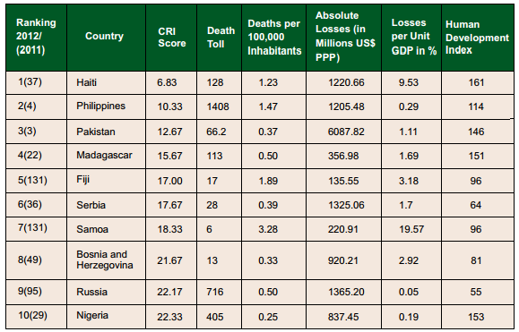
Global Climate Risk Index 2014
(German Watch)
Notes:
34

Slide 35
DM Experiences

Slide 36
Recent Disasters
Cyclones
Displacements
Yemyin-2007
Phet-2010
Malakand - 2009 / 10
Earthquakes
Ziarat-2008
Dalbandeen-2010
Maskhel and Awaran 2013
Landslides / GLOF
Attabad-2010
Gyari - 2012
Floods: 2010, 2011, 2012, 2013, 2014
Drought
Tharparker (2014)
NWA - 2014
Karli (AJK) – 2014
Reshun - 2013
Nilopher - 2014
  We learnt valuable
  lessons during the process

Slide 37
Capacity Building Program

Slide 38
Urban Search and Rescue (USAR)
IHK

Slide 39
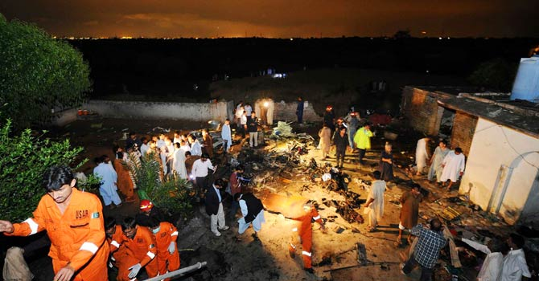
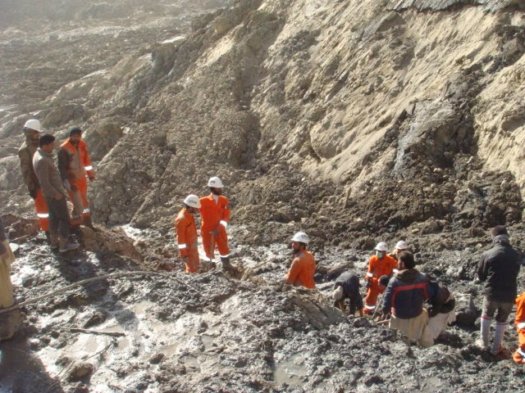
Program for Enhancement of
Emergency Response (PEER)
Community Action for Disaster Response (CADRE) – 149 officials trained
Hospital Preparedness for Emergencies (HOPE) course – 144 officials trained
Medical First Responders (MFR) – 257 officials trained
Collapsed Structure Search and Rescue (CSSR) – 188 officials trained
USAR Team at Bhoja Air Crash
USAR Team at Attabad Lake
Notes:
39

Slide 40
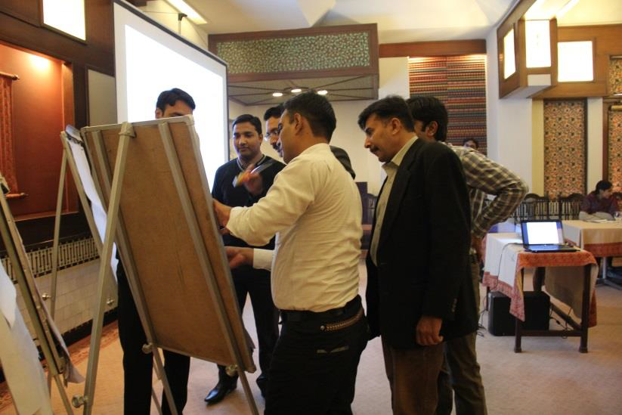
Capacity Building Training
DDMAs capacity to respond to disasters is limited due to lack of trainings
Training program undertaken in collaboration with UNOCHA and PDMAs
73 Flood prone districts selected for training (all provinces / regions)
1092 Govt officials have been imparted training in two phases
3rd Phase of training has commenced in Nov 2014
Cont…..
Notes:
40

Slide 41
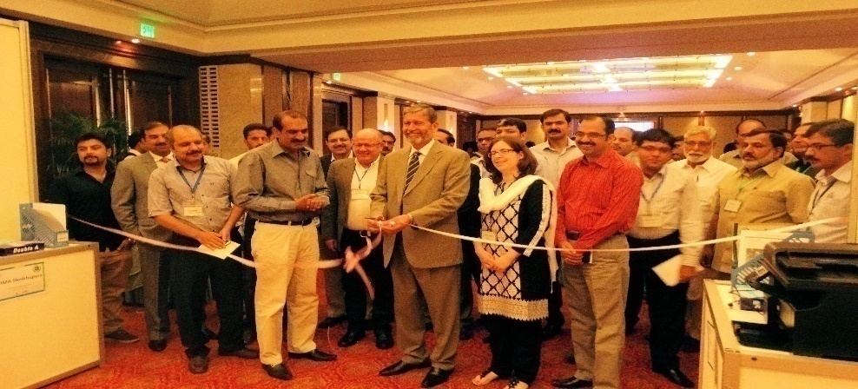
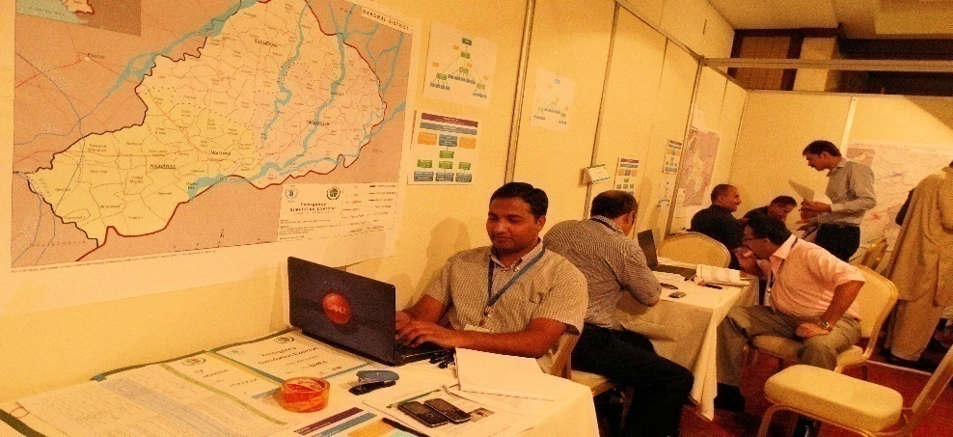
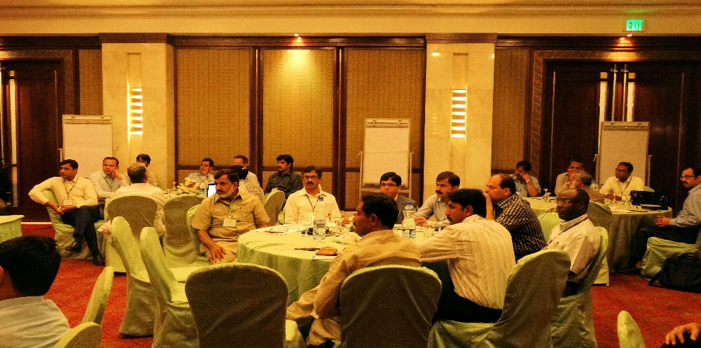
Capacity Building Training
Capacity of Line Departments for damage assessment is being enhanced through MIRA trainings
Emergency Simulation Exercise (Disaster Management) – pilot project for 3 selected districts of Punjab - Conducted in Lahore from 17-20 Jun 14
Exercise was aimed at enhancing capacity of stakeholders and practicing them in various aspects of Disaster Management
Notes:
41

Slide 42

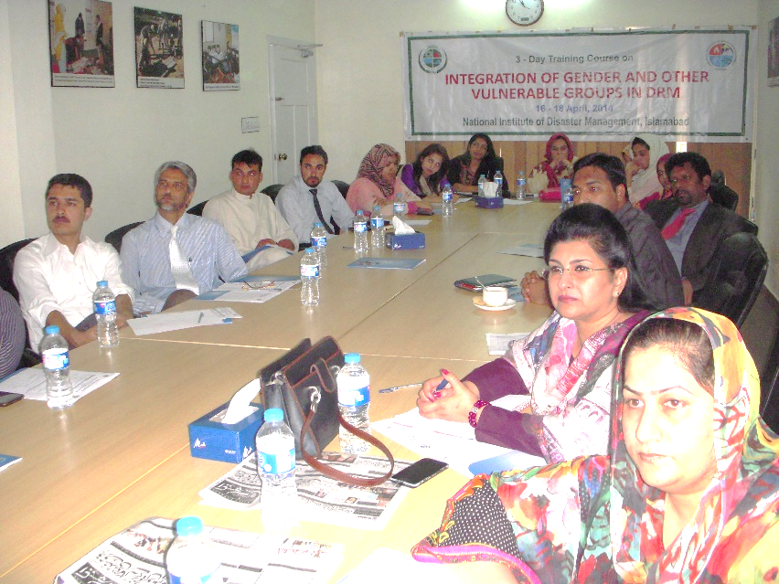
National Institute of DM (NIDM)
Re-activated in Jul 2013
Aimed at providing quality capacity building training and research services on DRM to public and private sector
Short duration courses / workshops (3-7 days) being conducted
Diplomas and Master Degree programs being planned in collaboration with Universities
58 short duration courses on DRR, DRM, Contingency Planning, Response and Rehabilitation have been conducted (1794 Officials trained)
Cont…..
Notes:
42

Slide 43
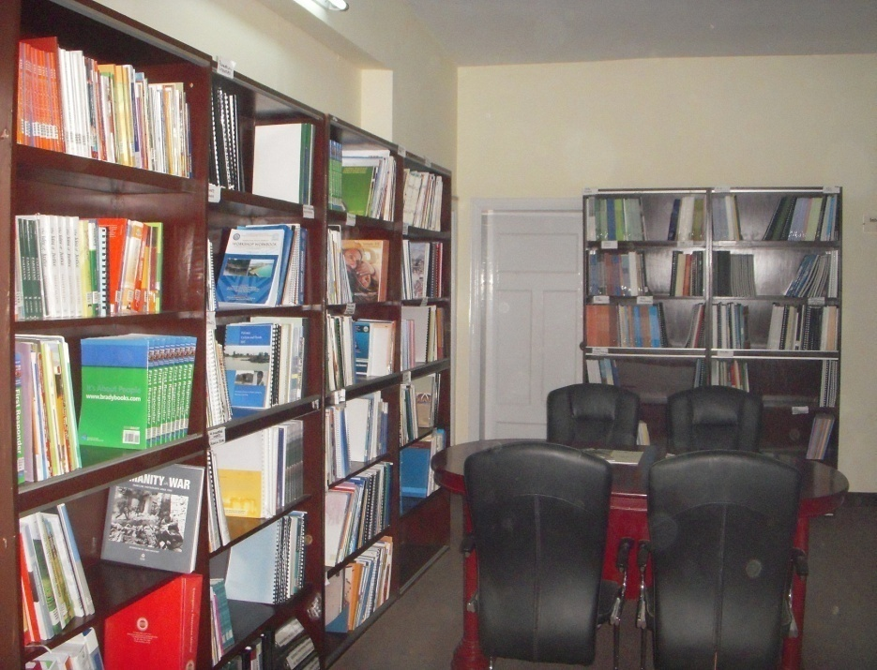
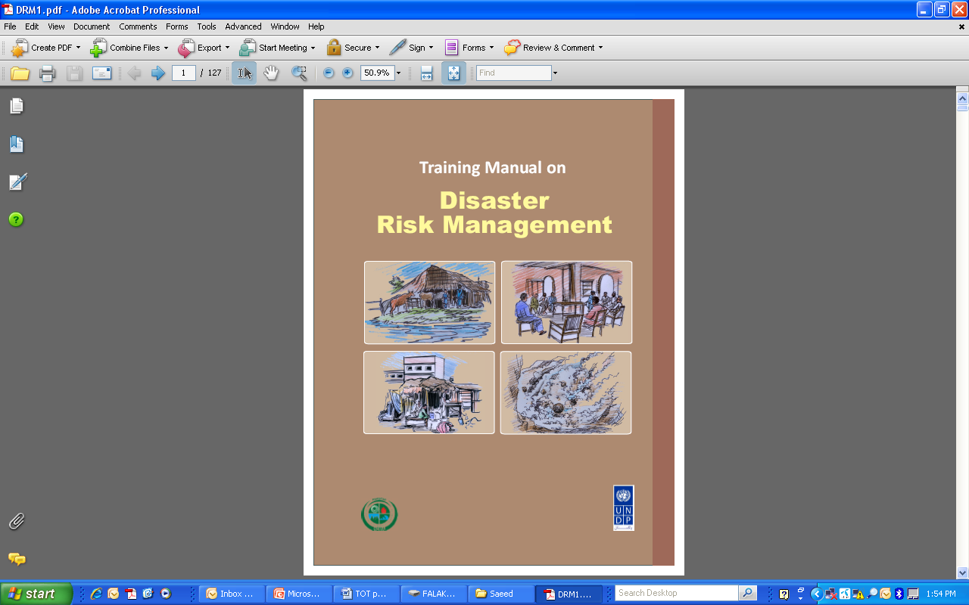
Progress Achieved
Development of modules for short courses
Training manuals in English and Urdu
Establishment of disaster information resource center
Development of database & NIDM website
Formulation of curriculum for universities for BS and MS degrees in collaboration with Higher Education Commission
Notes:
43

Slide 44
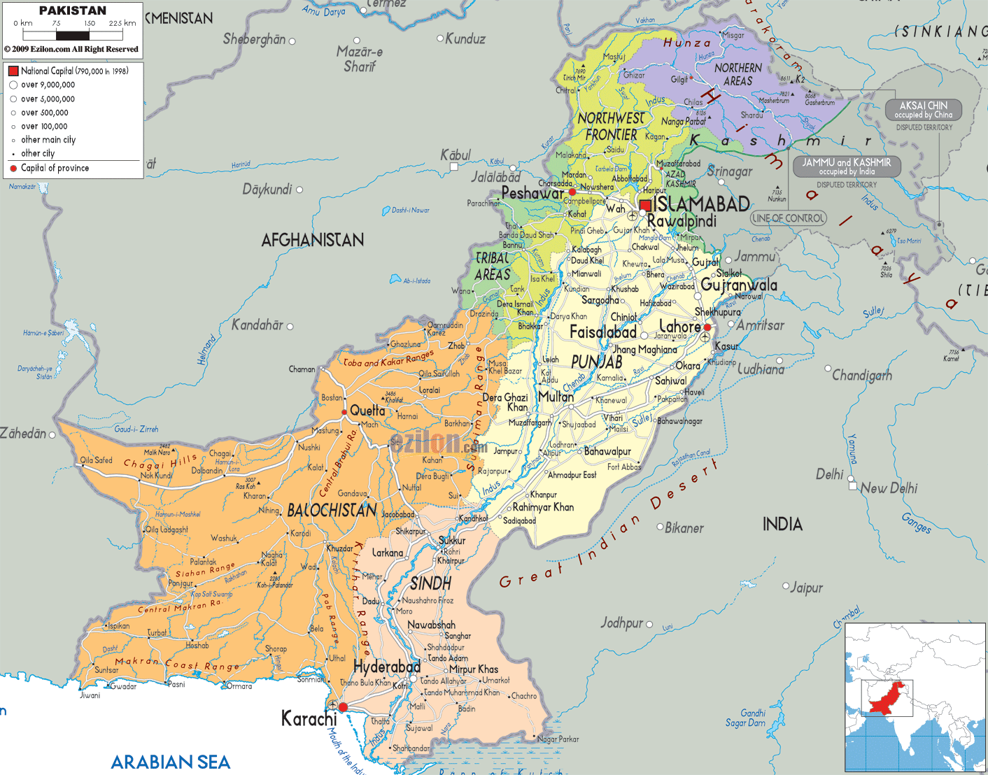
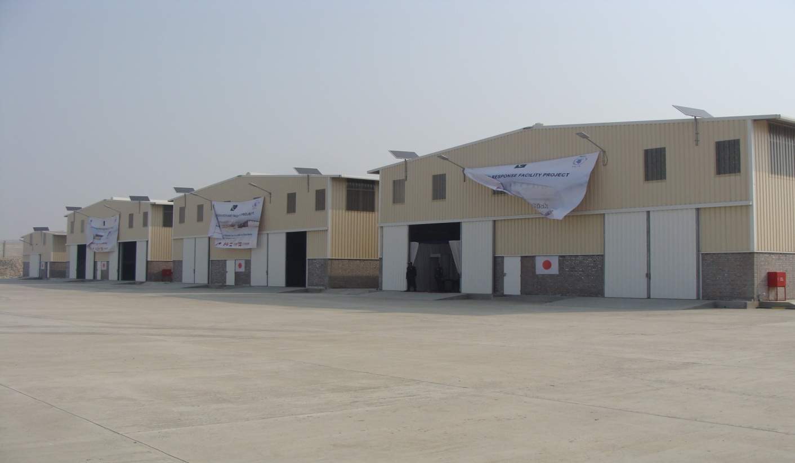
Humanitarian Response
Facilities
Gilgit
MZD
IOK
Peshawar
Islamabad
9 Strategic Warehouses being Constructed
Under construction
Completed
Completed
Lahore
Quetta
MZG
Sukkur
Under construction
HYD
Notes:
44

Slide 45
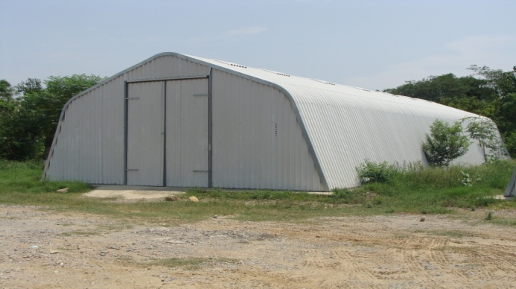
FLOSPANs
Hunza
Ghizar
3
1
Chitral
Gilgit
1
Diamir
Shangla
2
K. Stan
2
Sakardu
Athmuqam
Dir
4
2
3
Jamrud
1
B. Gram
IOK
Torgar
4
1
MZD
Hattian
2
Hangu
Mansehra
36 FLOSPANs completed in 2013
24 in progress
Kurram
1
Bagh
Gujrat
2
3
S. Waziristan
Tank
Sialkot
Zhob
DIK
Jhang
1
5
Bhakar
Q. Saifullah
2
Layyah
L Lai
7
MZG
Kalat
6
Sibi
Rajanpur
6
8
Bahawalpur
Nasirabad
4
Jaffarabad
5
Shikarpur
R.Y.K
1
Khuzdar
Larkana
2
Dadu
4
3
N. Feroz
Turbat
5
6
Mtiari
B. Abad
3
7
MPK
Gwadar
10
8
Thata
9
Tharparkar
Badin
Notes:
45

Slide 46
Floods Management

Slide 47
Flood Management Experience
Major flood events occurred during 1959, 1973, 1976, 1988, 1992, 1996, 2001, 2007,2010, 2011 & 2012
Diversity in flood events (riverine / flash / urban/ hill torrents / monsoons / cyclone)
Changing geographic spread due to monsoon shift and climate change impacts
Diversity in response patterns between provinces due to variation in capacities
Notes:
47

Slide 48
Flood Management System
Flood fighting - by the Irrigation Departments and Army
Maintenance of flood infrastructure - by PIDs
Barrage operation - by Provincial Irrigation Departments (PIDs)
Canal water regulation - by IRSA
Regulation of Dams - by WAPDA
Receipt of Indian flood discharge data - by PCIW
Weather and flood forecast generation - by PMD, FFD
National level Strategic Guidance and Contingency Planning by NDMA
Flood Management Planning – by FFC (implementation through PIDs)
Resulting disasters are managed by DDMAs / Provincial / National Institutions
Notes:
48

Slide 49
Monsoon Contingency Planning
Prevention / Mitigation – Priority
Scenario based response – Dictated by seasonal weather forecasts
Comprehensive and Integrated approach for development of appropriate plans, establishing clear goals
Bottom Up approach
Tiered Response - DDMAs are the ‘First Responders’ and focal points of all DM efforts
Provinces/Regions must build capacity to handle caseloads of ‘Likely Scenario’
NDMA provides national backup and intervenes in situations beyond provincial capacities
Notes:
National Disaster Response Plan (NDRP)
National Disaster Management Plan (NDMP)
Industrial / Technical Disaster Plan
Contingency Plans
Monsoon
Winter
Marine
Cyclone
Air Crash Management SOP
49

Slide 50
Results Achieved

Slide 51
Comparison of River Peak Levels
River | Site | Design Capacity (In Lac Cusecs) | Year |  |  |  | % increase in River flows in 2013
 |  |  | 2012 |  | 2013
 |  |  | Peak level (In Cusecs) (From Jul, Aug, Sept) | Date | Peak Level (In Cusecs) (From Jul, Aug, Sept) | Date
Indus | Guddu | 12 | 236,000 | 13 Sept | 567400 | 21 Aug | 140 %
 | Sukkur | 9 | 214,800 | 14 Sept | 510900 | 24 Aug | 138 %
Kabul | Nowshera | - | 100,700 | 8 July | 130700 | 15 Aug | 29.8 %
Jhelum | Mangla | 10.6 | 97,900 | 19 Sept | 109200 | 15 Aug | 11.5 %
 | Rasul | 8.5 | 41,200 | 5 Aug | 50,700 | 27 Sept | 23 %
Chenab | Marala | 11 | 150,300 | 5 Aug | 244,800 | 15 Aug | 63 %
 | Qadirabad | 8.07 | 194,800 | 5 Aug | 358,500 | 16 Aug | 84 %
Ravi | Balloki | 2.25 | 60,800 | 24 Aug | 117,800 | 19 Aug | 94 %
Sutlej | Sulemanki | 3.25 | 21,500 | 24 Sept | 82,100 | 22 Aug | 281 %
Notes:
51

Slide 52
Damages and Losses Comparison
Year | Deaths | Injured | Affected Population | Houses Damaged | Villages Affected | Cropped Affected Area (Acres)
2011 | 520 | 1,180 | 9,344,960 | 1,604,406 | 40,217 | 2,196,688
2012 | 571 | 2,902 | 4,849,841 | 636,438 | 14,159 | 1,172,045
2013 | 333 | 173 | 1,489,063 | 79,943 | 8,297 | 1,107,260
Reduction in 2013 from 2012 | 238 | 2,729 | 3,360,778 | 556,495 | 5,862 | 64,785
% age Reduction | 41.7 % | 94 % | 69.3 % | 87.4 % | 41.4 % | 37.7 %
Notes:
52

Slide 53
Way Forward
Build Resilience through DRR and Better Preparedness

Slide 54
Shifting Focus on DRR
Mega disasters – 2005 Earthquake and 2010 Floods
Cumulative losses last 4 years floods – Over $18 Billion
1 $ Spent Saves 7 - therefore
Shifting focus from Response to Risk Reduction

Slide 55
Preparedness Framework
Disaster Management Act 2010
National Disaster Risk Reduction Policy
National Policy Guidelines on Vulnerable Groups
Policy
National Disaster Management Framework
National Disaster Response Plan (NDRP)
National Disaster Management Plan (NDMP)
Response Plans
Air Crash Management SOP
Provincial Disaster Planning Guidelines
District Planning Guidelines
Guidelines on DRR Mainstreaming
Guidelines for Flood Management
SOPs / Guidelines
Contingency
Plans
Monsoon
Winter
Marine
Cyclone
Industrial Accidents
Drought
Tsunami
Earthquake
Urban Disasters
Notes:
National Disaster Response Plan (NDRP)
National Disaster Management Plan (NDMP)
Industrial / Technical Disaster Plan
Contingency Plans
Monsoon
Winter
Marine
Cyclone
Air Crash Management SOP
55

Slide 56
DRR Initiatives
DRM Needs Report through consultative process
National Disaster Risk Reduction Policy 2012
National Disaster Management Plan 2013 - 22

Slide 57
National DRR Policy
Pillars of DRR Policy
Prevention & Mitigation
Preparedness
Risk Knowledge
Risk Atlas or Index at national level
Local/ District level Risk Assessments
Damage and Loss Data-base
Climate Change focused Research
Local level DRR in high-risk areas/communities
Promoting “Risk Conscious” & Resilient Development
Resilient Key-Infrastructure and Life-Lines
Promoting Risk Awareness and Knowledge
Multi-hazard EWS
Integrated national preparedness capacity
Disaster Risk Financing Mechanisms

Slide 58
National DM Plan 2013 - 22
10 disaster management priority areas
118 interventions
National Disaster Management Plan (NDMP) – 2013-22
Addresses complete spectrum of DM
Estimated cost $1041 M

Slide 60
National Policy Guidelines on
Gender and Vulnerable Groups
Vision: To ensure that the needs and concerns of vulnerable groups (gender, children, aged and disabled) are addressed in all phases and all types of disasters.”
Obj 1: Needs and concerns of vulnerable groups integrated in all policies for natural and man-made disasters
Obj 2: Institutions strengthened and coord mechanisms developed to address needs and concerns of vulnerable groups at all levels
National GCC Framework – 2014-2017 - endorsed by all regions
Coord mechanisms established between Federal and Provincial levels
Policy Guidelines to Mainstream Needs & Concerns of Vulnerable Gps
Capacity Building Workshops held in all provinces / regions

Slide 66
Thank You

Slide 68
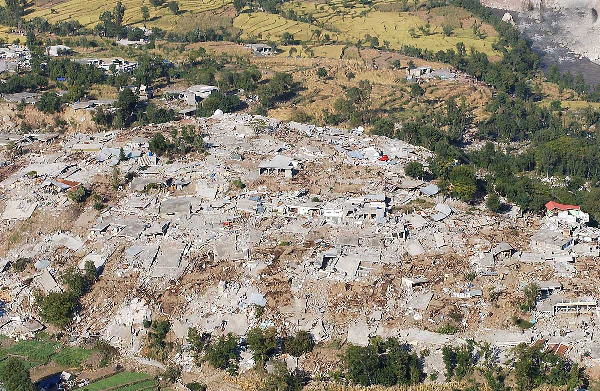
Earthquake - 2005
A Wake up Call
Human Loss - 73,338
Injured - 1,28,309
Families Affected - 500,000
Houses - 7,87,583
Educational Institutes - 1,1456
Health institutes - 782
Roads - 1,1963 kms

Slide 69
Provincial Resolution
“The Provincial Assembly of the Punjab in pursuance of Article 144 of Constitution of Islamic Republic of Pakistan passes a Resolution to the effect that Parliament (Majlis-e-Shoora) may by Law regulate the setting up of the coordinated and comprehensive National Disaster Management System and provide for matters connected therewith or incidental thereto”

Slide 71
Pakistan’s Vulnerability to Climate Change
5th IPCC Assessment Report
Devastating super floods in 2010 and 2011
Large scale flooding in 1992, 1997, 2003, 2006, 2012, 2013 and 2014
Localized cloud bursts rains causing urban flooding of Lahore (1996), Islamabad (2001) and Karachi (2009) and also Karachi (2013) and Sialkot (2013 & 2014)
History’s worst drought during 1999-2002; drought in Thar area of Sind and Cholistan area of Punjab in 2014
Intense heat wave during 2003, 2005, 2007 and 2010 (53.7 C)
Severe Cyclonic storms in 1999, 2007 and 2010

Slide 72
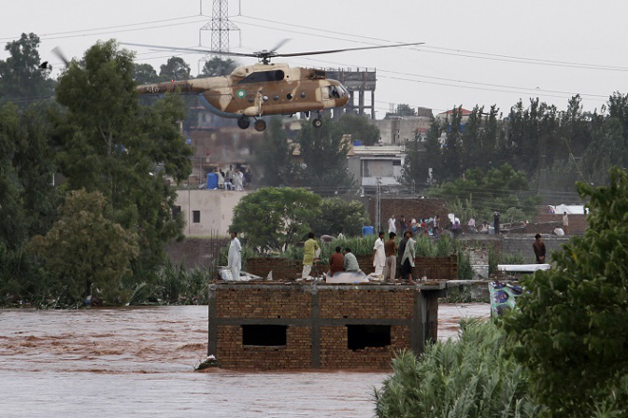
Floods - 2014

Slide 73
Overview Floods 2014
Inconsistent monsoon behavior - (Intensity, Spatial spread)
Heavy downpours in short time span (3-5 Sep)
Palandri - 668 mm
Rawalakot - 440 mm
Lahore - 350 mm
Kallar - 347 mm
Mangla - 338 mm
Islamabad - 316 mm
Sialkot - 316 mm

Slide 74
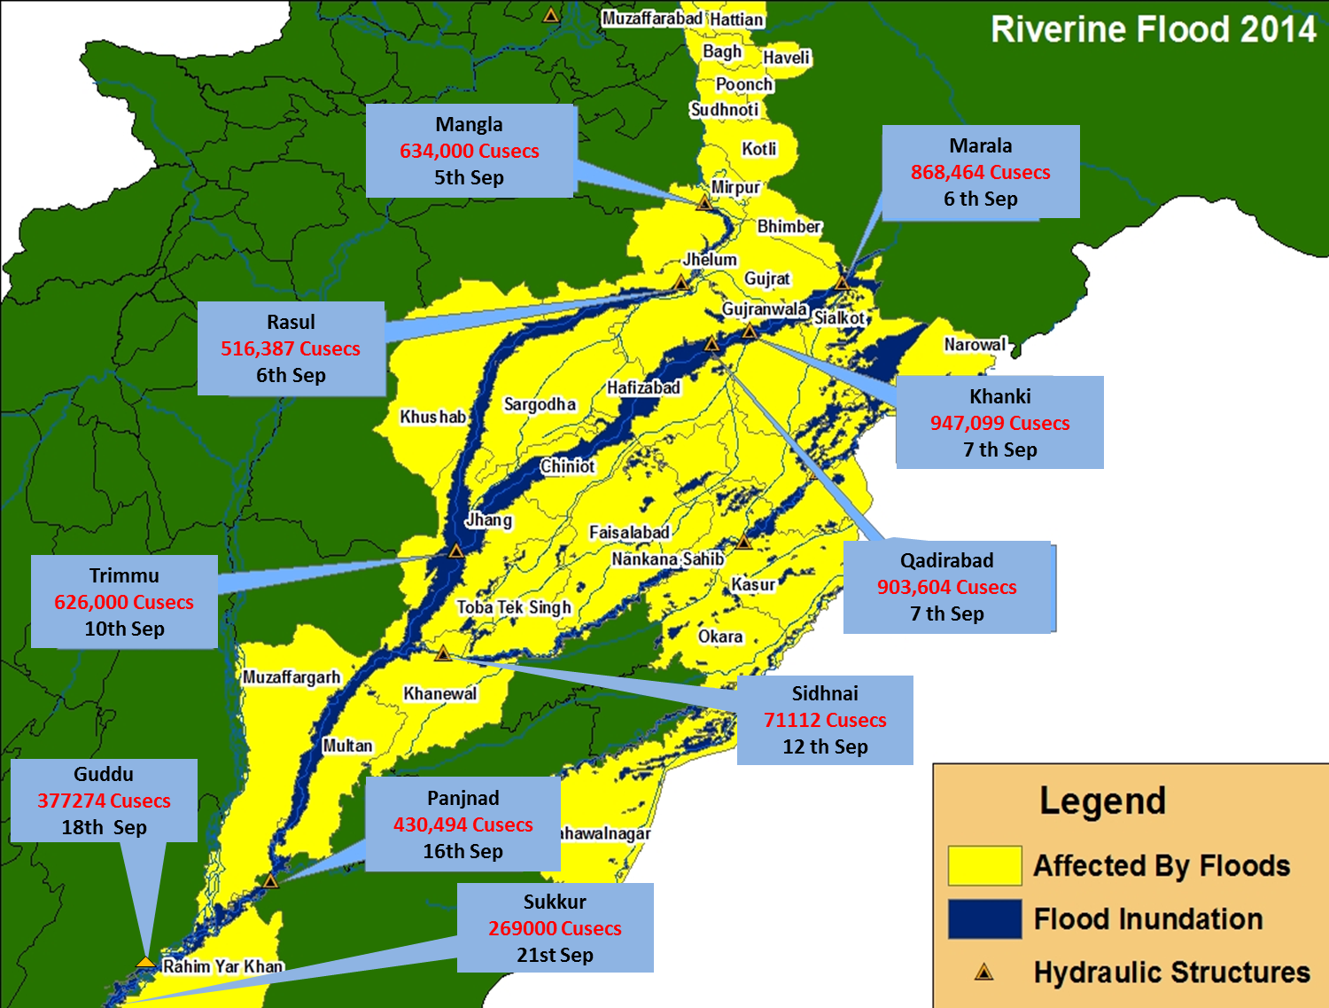
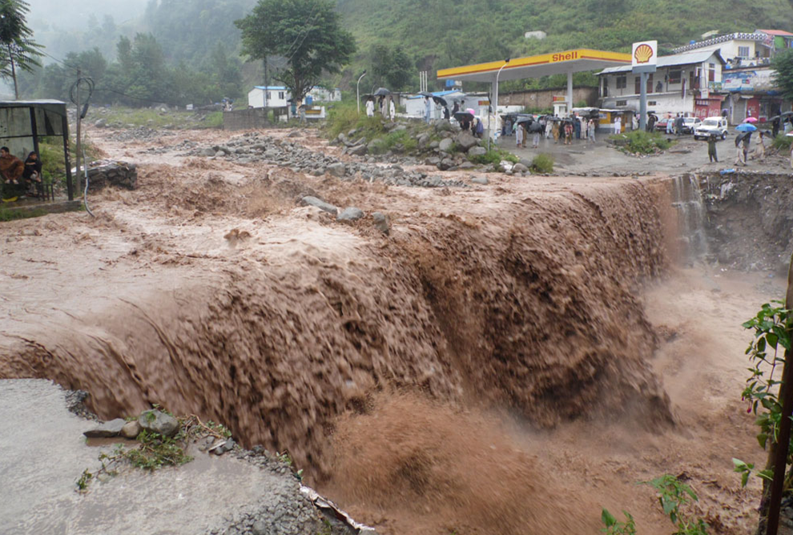
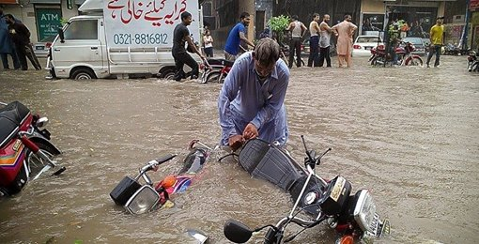
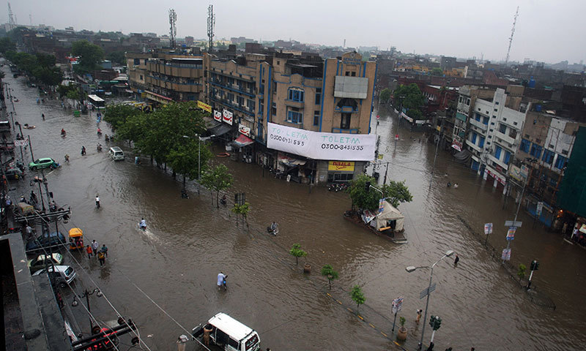
Overview - Floods 2014
Impact of Heavy Rains
Flash floods and land slides in North and North Eastern part of country
Urban flooding in major population centers
Riverine floods in Ravi, Chenab and Jhelum

Slide 75
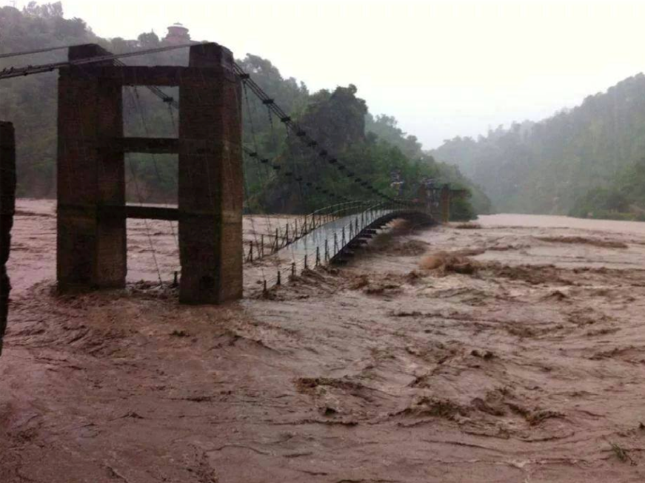
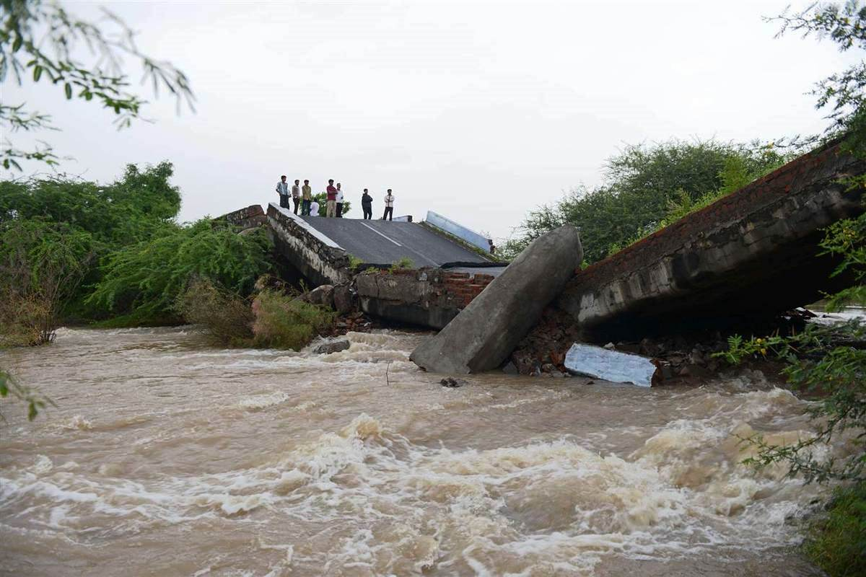
Damages / Losses
Population Affected - 2.53 M
Deaths - 367
Injured - 673
Villages Affected - 4,065
Crops Affected - 1 M acres
Houses Damaged - 142,205
Cattlehead perished - 7,294

Slide 76
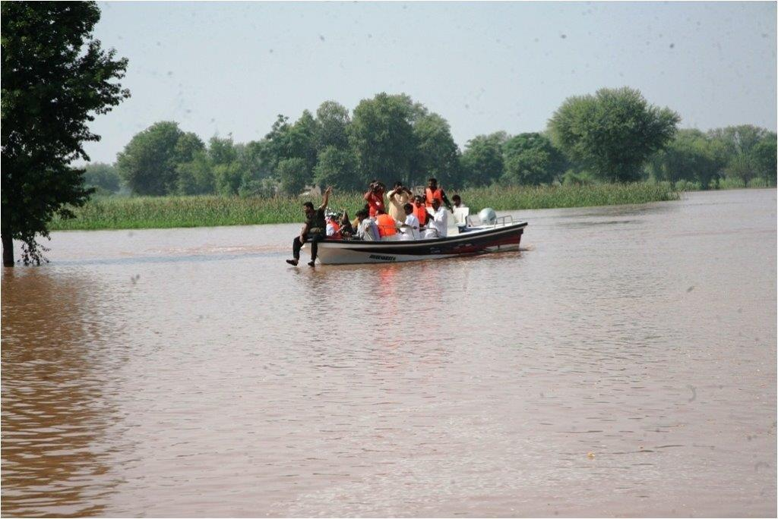
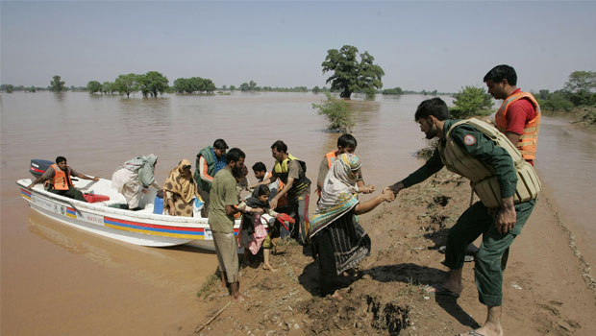
Response
Rescue and Evacuation
Resources Employed
Helicopters - 19
Boats - 574
Persons rescued - 170,840
Persons evacuated - 683,655

Slide 77
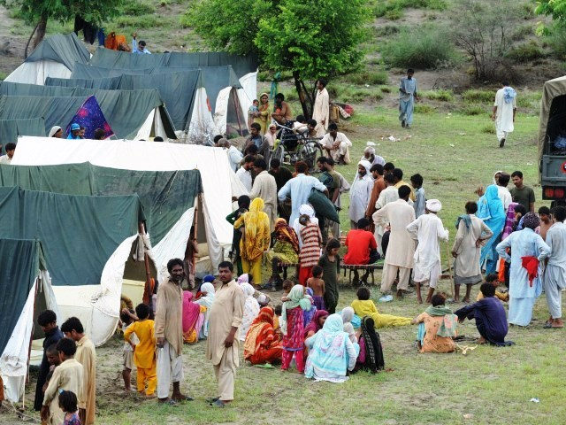
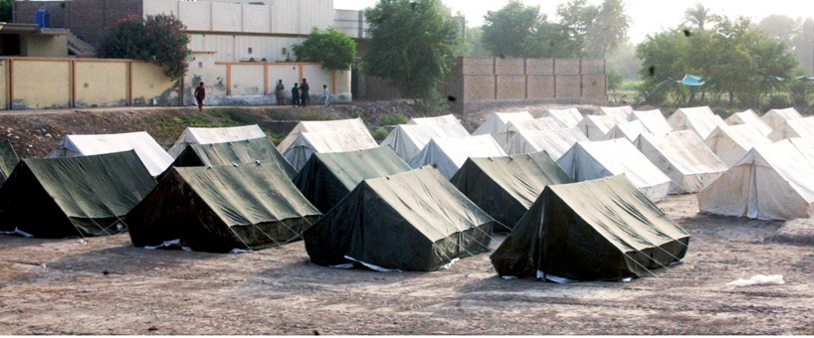
Response
Relief by Govt
Tents | 95,395
Blankets | 27,290
Plastic Mats | 12,640
Food Packs | 198,463
Mineral Water Bottles | 307,524
Aqua Tablets | 3,530,000
Dewatering Pumps | 18
Water Filtration Plants | 40

Slide 78
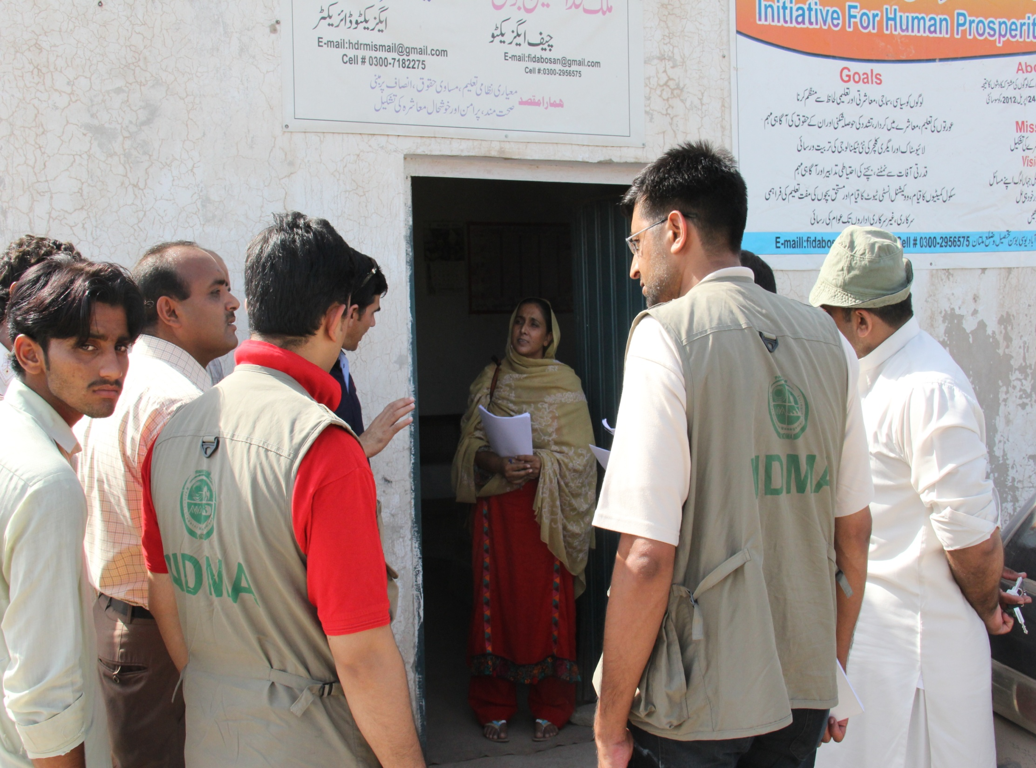
Multisector Initial Rapid Assessment
Conducted in 5 districts of Punjab (Mandi Bahaudin, Hafizabad, Chiniot, Jhang & Multan) by NDMA, PDMA and UN jointly from 12 – 30 Sept
Punjab, AJ&K and GB also conducted Initial Damage Assessment

Slide 79
Outcomes of MIRA
Population affected - 947,194
Households affected - 157,865
Area inundated (SUPARCO) - 0.959 M acres
Crop damaged - 873,261 acres
Number of houses in affected area - 270,574
  Completely damaged - 43,082 (16%)
  Partially damaged - 54,114(20%)
Schools damaged - 327
Health facilities damaged - 75% functional
Roads inundation - 1547 KM (38%)

Slide 80
Recovery Need Assessment (RNA)
UNDP was asked to carry out Recovery Need Assessment
Process was completed in Oct 2014 and presented to Donors on 11 Nov 2014
Process of RNA was supported by NDMA, PDMA and District Authorities
RNA has identified recovery needs in following sectors
Agriculture
Livelihood
Housing
Community Infrastructure
DRR

Slide 81
Damages Reported by RNA
Sector | Punjab | AJ&K | Total
Housing | 101,515 | 28,365 | 129,880
Crops | 1,004,764 | 1,309 | 1,006,073
Farmers Affected | 244,332 | 6,115 | 250,447
Cattlehead Perished | 754 | 1,171 | 1,925
CPI Schemes | 2,580 | 2,644 | 5,224

Slide 82
Cost of Recovery Reported by RNA
Sector | Punjab | AJ&K | Total
Housing | 11,163.01 | 1,430.35 | 12,593.32
Crops | 10,851.44 | 63.08 | 10,914.52
Livelihood support | 2,723.80 | 17.79 | 2,741.59
Livestock | 216.00 | 17.47 | 233.47
CPI | 15,945.55 | 1,218.84 | 17,164.38
DRR capacity building | 250.00 | 100.00 | 350.00
Total in Pak Rs. M | 41,149.79 | 2,847.53 | 43,997.28
Total in US$ M | 411.50 | 28.47 | 439.97

Slide 83
Summary – Recovery Plan
Time span – 24 months (subject to availability of funds)
Funding by Government, Donors, Non-Governmental Organizations
Govt lead implementation and monitoring mechanism
Adding resilience into infrastructure, institutions and communities
Special focus on vulnerable groups

Slide 84
Damage Need Assessment (DNA)
A tool to estimate reconstruction cost in terms of damage to infrastructure
Focused economic impacts can be calculated through DNA
To complete in 3-4 months
World Bank and Asian Development Bank have been asked to conduct DNA
Reconstruction would be based on results / recommendations of DNA
Reconstruction would embed DRR priorities and initiatives in line with NDMP and National DRR Policy
Build Back Better would be ensured through proposed interventions

Slide 85
Floods – Damages / Losses
Year | Lost Lives (No) | Population Affected | Houses Damaged | Crop Area Damaged (Acres) | Direct Loss (US $ Million)
2010 | 1,985 | 20 M | 1,608,185 | 5,171,026 | 10,056
2011 | 516 | 9.3 M | 999,388 | 2,177,072 | 3,730
2012 | 571 | 4.8 M | 636,438 | 1,172,045 | 2,640
2013 | 333 | 1.49 M | 79,943 | 1,107,260 | 2,000
2014 | 367 | 2.53 M | 129,880 | 1,006,073 | 439.97
Total | 5,300 | 55.5 M | 4.9 M | 10.6 M Acres | US $ 18,866

Slide 86
Relief Provided - Past Floods
 | 2010 | 2011 | 2012 | 2013 | 2014
Case load | 20 M | 9.6 M | 4.77 M | 1.45 M | 2.53 M
Relief Provided
Tents (Nos) | 488,782 | 316,575 | 132,892 | 57,834 | 95,395
Blankets (Nos) | 1.915 M | 86,030 | 24,137 | 17,187 | 27,290
Mosquito Nets (Nos) | 290,262 | 435,498 | - | 31,250 | 23,900
Food Items | 408,678 Tons | 3.717 M Packs | 819,434 Packs | 126,550 Packs | 198,463
Water Purification Plants( N0s) | 3,896 | - | - | 63 | 40
Notes:
86

Slide 87
Tharparkar Situation

Slide 88
Tharparkar Situation
Present drought is continuation of episode started in Feb 2014
Govt of Sind provided relief, medical support and free wheat to alleviate the sufferings of population
PM announced Rs 1 Bn as financial assistance through BISP for people of Thar
Situation got stabilized and even improved with scattered spells of rain in the region
Recent media hype has once again brought the subject of Tharparkar to the forefront highlighting child mortality
482 deaths have been reported since 1 Dec 2013 (95 male, 102 female, 285 children)

Slide 89
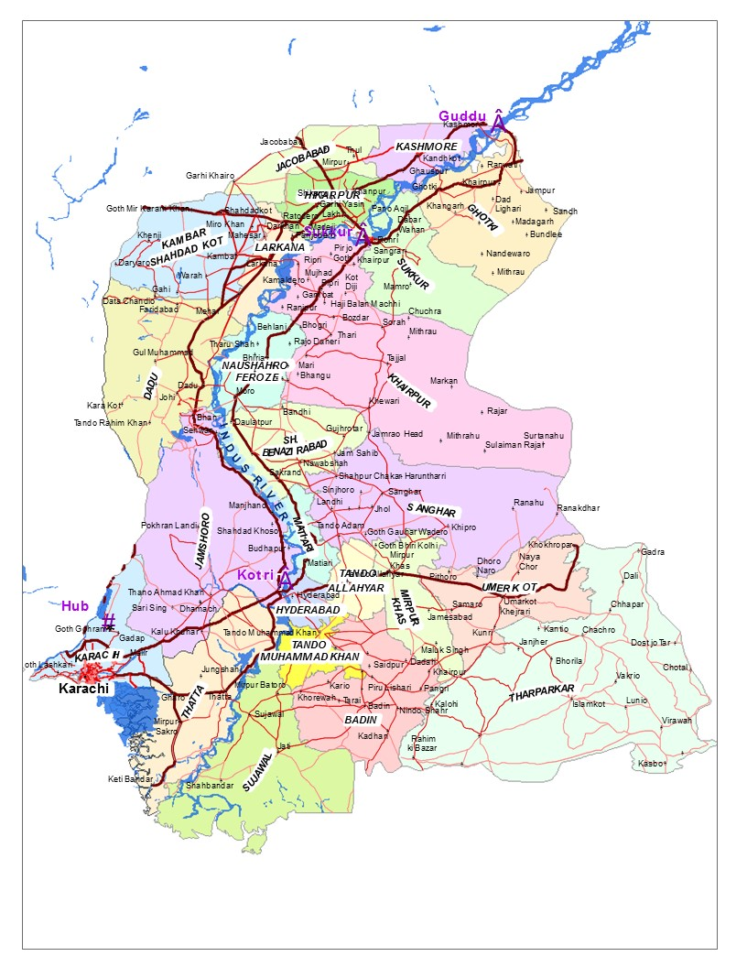
Drought Situation - Overview
It is the continuation of drought which started February 2014
Dadu
Total Districts : 24
Affected Districts: 6
Severely Affected: 1
Jamshoro
Hyderabad
Thata
Tharparkar
Badin
Sindh experienced its worst droughts in 1871,1881,1899,1931,1947 and 1999
Source: National Drought Monitoring Centre

Slide 90
RAINFALL IN SIND - 2014
Poor Rainfall - 2014
Sind received 78% less rainfall
Dadu
Affect of less rain is more on Thar as compared to western districts because of non-availability of irrigation channels
Jamshoro
Hyderabad
Tharparkar
Rainfall 2014
52 / 184 mm (28 %)
Thata
Badin
Source: National Drought Monitoring Centre – Drought Watch Bulletin Sep 2014)

Slide 91
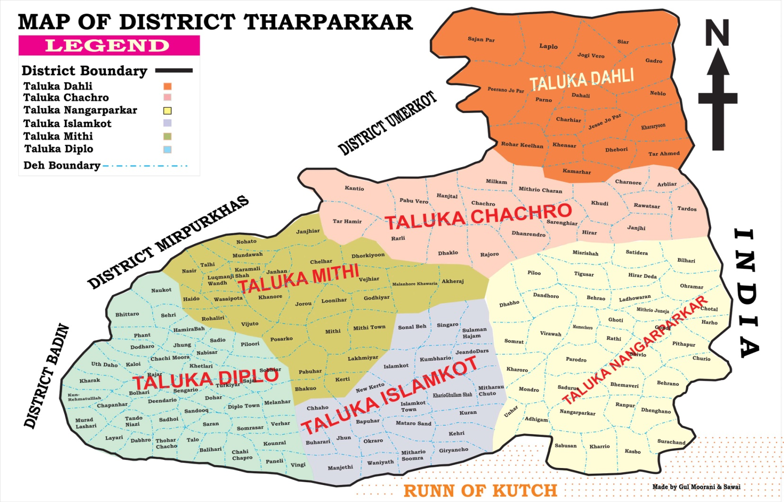
THARPARKAR RAINFALL – 2014
Rainfall data: 20 Apr – 4 Sep 14
Average : 24 Years (1991–2004)
Rainfall – 2014
33 / 214 mm (15%)
Rainfall – 2014
33 mm
Rainfall – 2014
180 / 245 mm (73%)
Rainfall – 2014
167 / 281 mm (59%)
Rainfall – 2014
77 / 403 mm (19%)
Rainfall – 2014
43 / 285 mm (15%)
Source: Thar District Administration

Slide 92
Drought Indicators
Poor Rainfall
Depletion of Surface & Sub Surface Water
Withering Away of Vegetation
Stress on Availability of Food
Scarcity of Fodder Leading to Diminishing Livestock
Forced Migration

Slide 93
ASSESSMENT BY NDMA TEAMS
Water Situation
Drying of wells at small scale is apparent: situation is not alarming but can deteriorate in coming months, if no rain occurs
Installation of 750 RO plants would alleviate the water shortage

Slide 94
THAR DROUGHT SITUATION
Moderate Drought Likely to intensify in coming months in absence of rains

Slide 95
ASSESSMENT BY NDMA TEAMS
Taken in April 2014
Current Picture 2014
Water level
Decreasing Water levels
(Nagarparkar Check Dam)

Slide 96
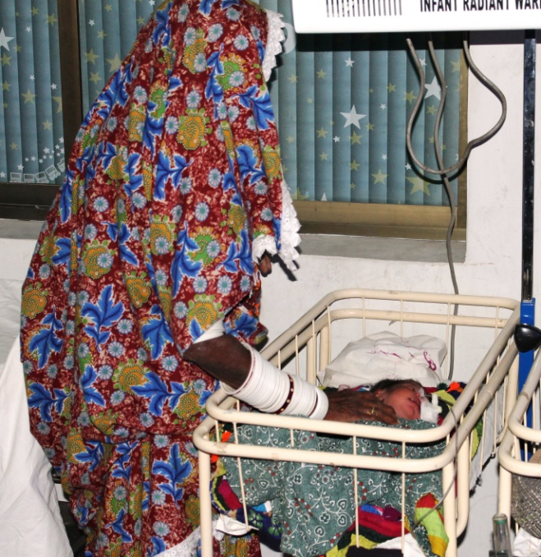
ASSESSMENT BY NDMA TEAMS
Health
285 deaths of under 5 years children are reported since Dec 2013; out of which 6 are attributed to malnutrition and remaining with various birth related diseases
220 Doctors and 194 health facilities are present in Thar: but 90% dispensaries are not functional

Slide 97
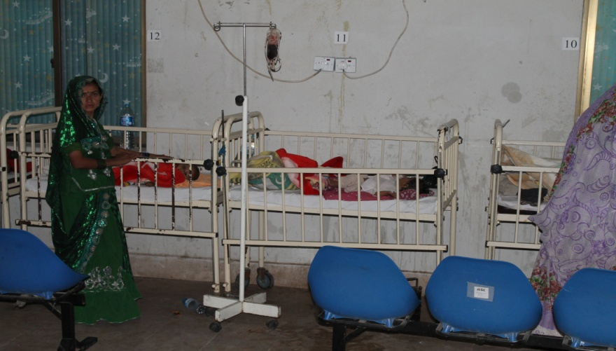
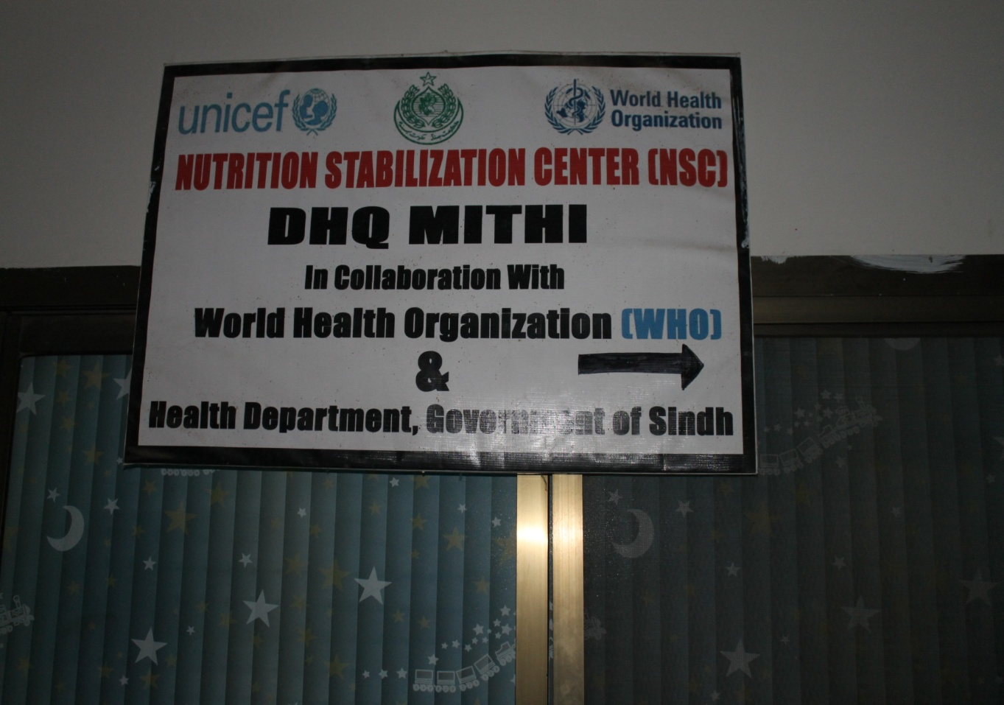
ASSESSMENT BY NDMA TEAMS
Health
Sufficient amount of medicines / vaccinations are available in the district
Nutrition Stabilization Centre established by WFP / UNICEF at DHQ Hosp is working efficiently
Deterioration in primary healthcare in rural areas is observed

Slide 98
ASSESSMENT BY NDMA TEAMS
Poverty
Poor Health Facilities
Lack of Awareness
Child mortality remains an area of concern; however the reasons are not directly related to drought
Deaths

Slide 99
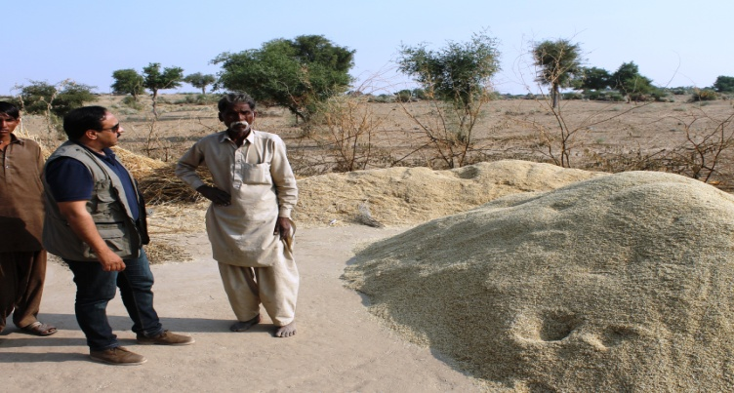
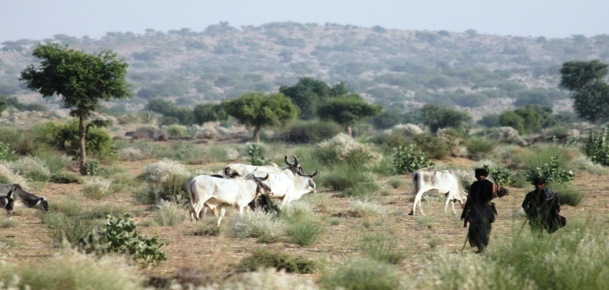
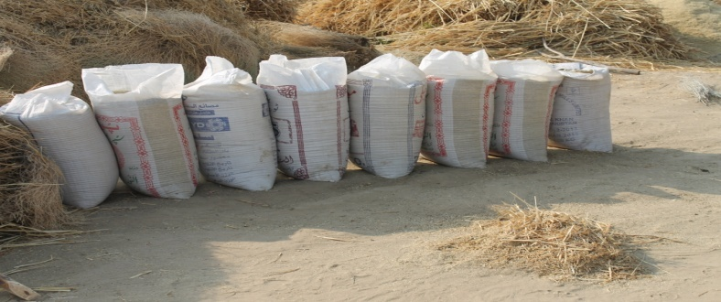
ASSESSMENT BY NDMA TEAMS
Agriculture
Millet and Guar are main crops in Thar; insignificant rains have resulted in poor yield
Area does not appear de-vegetated
Govt of Sindh is distributing free wheat to the community

Slide 100
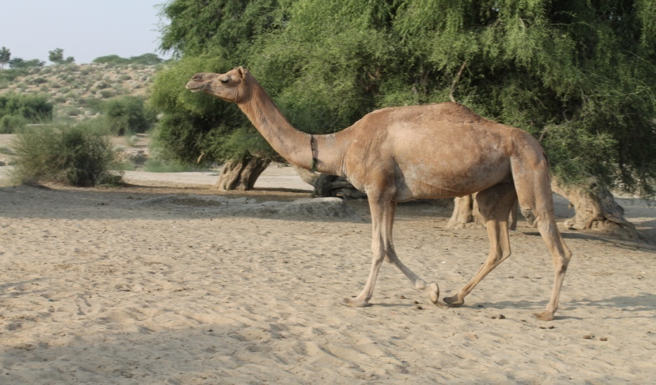
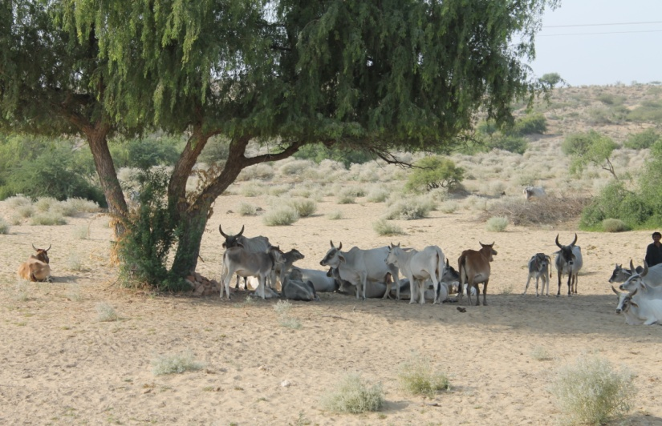
ASSESSMENT BY NDMA TEAMS
Livestock
District has 6.5 M animals (large and small)
No disease outbreak is reported and Live stock is being vaccinated regularly
Drought conditions have reduced fodder in the area
15-20% of cattle have migrated to barrage areas as a routine practice in harvesting season

Slide 101
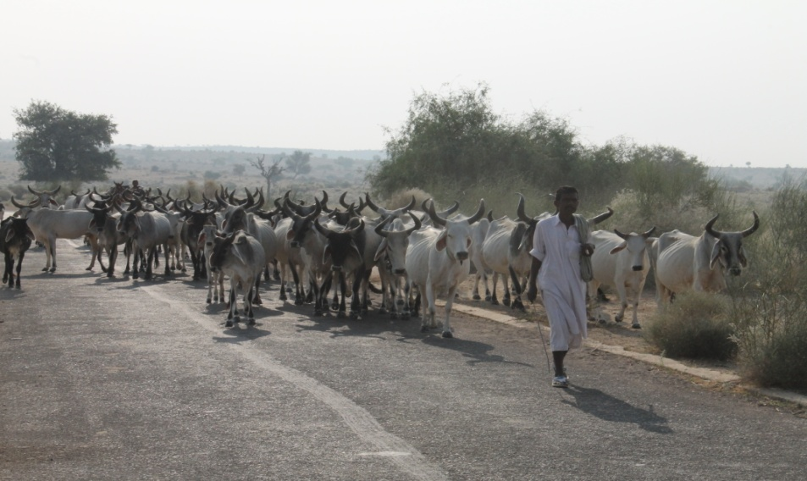
Conclusions
Affect of less rainfalls exasperated by lack of irrigation network in Thar
Area is water stressed and is likely to deteriorate, but acute water scarcity is not fully established
Partial effect on availability of fodder likely to be accentuated in winters
Malnutrition is one of the issues leading to medical problems
No unusual migration of livestock reported
Migration is as per usual practice. Beneficial for animals and population

